Slide 1
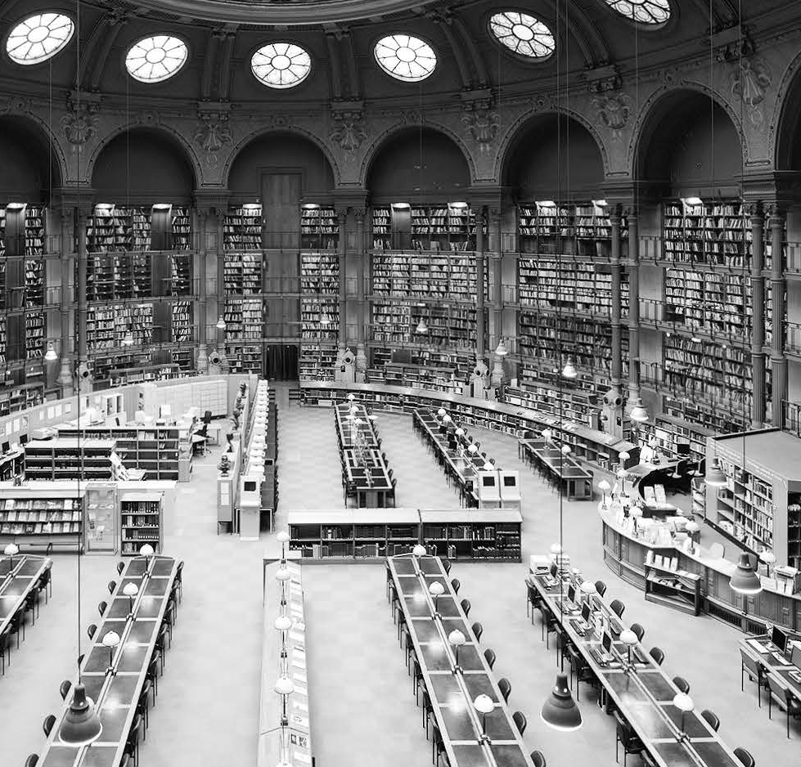
Unit 2
Economics

Slide 2

Objectives
学术阅读: Summarize the main ideas of a text and identify essential supporting points
学术视听: finding major points
学术口语: having clear objectives
学术写作: Macro structures: shaping an essay& Writing an outine; Micro skills: Writing a good research question

Slide 3
Contents
Reading
Viewing
Speaking
Writing

Slide 4

Reading
Text A
Text B

Slide 5
Reading
Text A
The Invisible Hand
Lead-in task
While reading
After reading tasks

Slide 6
Text A Lead-in
task
Critical thinking
Economics may seem to be a theoretical subject, but it permeates into everyone’s daily life. Take the Spring Festival as an example. What do you usually do to celebrate Chinese New Year? Write down your activities in the following table and analyze whose labor and skill are required to make them possible.
1 What is the power that leads people to work and cooperate?
Reference answers
The invisible hand.

Slide 7
Text A Lead-in
task
Critical thinking
2 What does the table reveal about economic life?
Reference answers
Our economic life is made possible by the skill and labor of vast numbers of total strangers. The activities of countless far-flung men and women have to be intricately choreographed and precisely timed. However, no one coordinates it, and yet they do cooperate. It’s “the invisible hand” — the mysterious power that leads innumerable people, each working for his own gain, to promote ends that benefit many. Out of the seeming chaos of millions of uncoordinated private transactions emerges the spontaneous order of the market.

Slide 8
Text A Lead-in
task
Critical thinking
What I do to celebrate the Spring Festival | People whose skill and labor are required
go back to my hometown by train | • ticket agent • driver • conductor • track maintenance workers …
decorate my home with couplets and art crafts
• calligrapher
• artisan
• shop assistant
• cashier
…
have the family reunion dinner on Spring Festival’s eve
• farmer
• cook
• waiter
• restaurant manager
…
go to Spring Festival fairs with my family
• fair organizer
• ticket agent
• supplier
• peddler
…

Slide 9
Text A While reading
The focused issue
The invisible hand
Reading task
What are the unseen forces that move the free-market economy?

Slide 10
Text A While reading
Supplementary Information
1. free-market economy
In a free market economy, the laws and forces of supply and demand, rather than a central government, regulate production and labor. The prices for goods and services are self-regulated by buyers and sellers negotiating in an open market. Most companies and resources are not owned by the state. Instead, they are owned by private individuals or entities who are free to trade contracts with each other.

Slide 11
Text A While reading
Supplementary Information
2. economic downturn
An economic downturn is a general slowdown in economic activity over a sustained period of time. It occurs when the value of stocks, property, and commodities fall, productivity either grows more slowly or declines, and GDP shrinks, stands still or expands more slowly. It can happen in a specific region (e.g. the Asian financial crisis in the late 1990s) or on a global scale (e.g. the global financial crisis in the late 2000s). The main features of an economic downturn include rising unemployment, falling share and house prices, low consumer confidence and declining investment.

Slide 12
Text A While reading
Supplementary Information
3. An Inquiry into the Nature and Causes of the Wealth of Nations
An Inquiry into the Nature and Causes of the Wealth of Nations, usually abbreviated as The Wealth of Nations, is Adam Smith’s masterpiece. It was first published in 1776, and is widely considered to be the first modern work in economics. Through reflection over the economics at the beginning of the Industrial Revolution the book touches upon broad topics such as the division of labor, productivity and free markets.

Slide 13
Text A While reading
Language Support
Individual buyers and sellers will act according to what is in their own best interests. (Para. 2)
The phrase “in one’s interest” means “for one’s benefit or advantage”（为了……的利益；为……着想）. There are some relevant expressions, such as “in the interest of one”, “in one’s own interest”, and “in one’s best interest”.
e.g. It’s obviously in their interest to increase profits.
I suspect it’s in your own best interest to quit now.

Slide 14
Text A While reading
Language Support
Customers are likewise typically looking out for their self-interests. (Para. 4)
The word “likewise” is used to signal a comparison that explains how things are similar（同样的；此外）.
e.g. In this episode, we will likewise deal with another extremely common question.
Just water these plants twice a week, and likewise the ones in the bedroom.
Other special words and expressions are often used to signal the comparison of two or more people, places, things, ideas, etc. Here are some examples of these signposts for your reference:
similarly, both, just as, and also, resemble, parallel, in the same manner, in the same way, alike, equally

Slide 15
Text A While reading
Language Support
The market becomes more efficient as buyers and sellers move in the same direction — as if directed by an invisible hand. (Para. 5)
这里的as if用于省略句。如果as if引导的从句是“主语＋系动词”结构，可省略主语和系动词，这样as if后就只剩下名词、不定式、形容词（短语）、介词短语或分词。
e.g. She left the room hurriedly as if (she was) angry.
Tom raised his hands as if (he was going) to say something.

Slide 16
Text A While reading
Language Support
Both the supporters and critics of the invisible hand theory can influence the way that nations tackle economic downturns. (Para. 8)
这里的the way是先行词，其后是that引导的定语从句。先行词是the way时，其后定语从句的引导方式有三种：
1) the way + that
e.g. I like the way that the teacher gives his lessons.
2) the way + in which
e.g. I don’t like the way in which he speaks to me.
3) the way + 从句（省略了that或in which）
e.g. There were several theories about the way the fire started.

Slide 17
Text A While reading
Language Support
Those who believe in the invisible hand are more likely to favor a hands-off or laissez-faire approach by the government regardless of the condition of the economy. (Para. 9)
regardless of: without taking into account 不管；不顾
e.g. He jogs every day regardless of the weather.
The club welcomes all new members regardless of age.

Slide 18
Text A While reading
Critical reading and thinking
Task 1 / Overview
Text A covers three aspects of the invisible hand: its definition, importance, and history. Read the text and complete the following table.
What is the invisible hand? | The invisible hand is a _________ for the unseen forces that _________________ _______.
What do people think of the invisible hand theory? | Supporters believe that if you leave market forces alone, it will ___________.
 | Critics argue that if you allow business owners great freedom, they’ll behave in a manner that will ___________________ _____.
metaphor
move the free market
economy
help everyone
harm more vulnerable
people

Slide 19
Text A While reading
Critical reading and thinking
Task 1 / Overview
Text A covers three aspects of the invisible hand: its definition, importance, and history. Read the text and complete the following table.
1776
What is the history of the invisible hand? | The concept dates back to ________. It appeared in a book written by the Scottish philosopher __________ entitled _________________________________ __________________.
Adam Smith
An Inquiry into the Nature and Causes of
the Wealth of Nations

Slide 20
Text A After reading tasks
Critical reading and thinking
Task 2 / Points for discussion
Work in groups of 4-5 and discuss the following questions.
According to Adam Smith, “the invisible hand” leads innumerable people, each working for his own gain, to promote ends that benefit many. However, some people think that the free market only promotes selfishness and greed, where businesses try every means to work for their own gain. What do you think? Can “the invisible hand” do anything to deter business malpractices? Give your explanations.

Slide 21
Text A After reading tasks
Critical reading and thinking
Task 2 / Points for discussion
Reference answers
Market has its own way of punishing business malpractices. For example, if a fast food chain sells contaminated food, nation-wide demand for their food will go down, along with their profit. When a company sells defective products, they have to deal with liability costs.

Slide 22
Text A After reading tasks
Language building-up
Task 1 / Specialized vocabulary
1 Translate the following expressions from English into Chinese. Pay attention to the terms in bold.
看不见的手
1 the invisible hand _______________________
2 public interest _______________________
3 stock the item _______________________
4 make purchases _______________________
5 priced too high _______________________
6 economic downturns _______________________
7 the rise of monopolies _______________________
8 look out for one’s own gain _______________________
公共利益
存货
购买
定价过高
经济衰退
垄断的兴起
关注自身利益

Slide 23
Text A After reading tasks
Language building-up
Task 1 / Specialized vocabulary
2 Complete the following sentences with the words and expressions in bold from Exercise 1. Change the form where necessary.
priced
1 Since oil futures are _______________ in dollars, crude prices tend to rise to offset the weaker currency.
2 Some consumers _______________ the products not only for consumption but also for the fear
of unavailability in the future.
3 No companies should be allowed to harvest our personal information for their own _______________.
4 For years Bell Telephone had a(n) _______________ on telephone services in the US.
stock
gain
monopoly

Slide 24
Text A After reading tasks
Language building-up
Task 1 / Specialized vocabulary
5 In The Wealth of Nations, Adam Smith showed that even though each individual pursued his own self-interest, through _______________ he was led “to promote an end which was no part in his intentions.”
6 Instead of using your physical plastic card to make _______________, a digital wallet allows you to pay in stores, in apps, or online.
7 For low-income families, the _______________ severely affects basic needs such as food security, healthcare and shelter.
8 This organization aims to promote the _______________ in sectors of great importance to socioeconomic and technological development.
the invisible hand
purchases
economic downturn
public interest

Slide 25
Text A After reading tasks
Language building-up
Task 2 / Academic vocabulary
Complete the following sentences with the words from the box. Change the form where necessary.
concept | item | incline | instinctively | invisible
option | overall | primarily | promote | regulate
1 Globalization is ___________ an economic process of interacting and integration that is associated with social and cultural aspects.
2 By focusing on raising education standards, we raise the value of human capital, thereby raising the performance of the ___________ economy.
primarily
overall

Slide 26
Text A After reading tasks
Language building-up
Task 2 / Academic vocabulary
3 Demand for the product is very strong and prices are ___________ to be high.
4 The company has established a number of behavioral guidelines to ___________ the activities of the company itself.
5 This website is the perfect place to shop online for cheap household ___________ and household gifts.
6 The company gives customers the ___________ to personalize their delivery orders with a sweet note or some additional instructions.
inclined
regulate
items
option

Slide 27
Text A After reading tasks
Language building-up
Task 2 / Academic vocabulary
concepts
7 Several economic ___________ are defined precisely at the beginning of this research paper.
8 He knew ___________ that there was something wrong with the current economic system.
9 Many companies are using social media to ___________ their products.
10 “___________ earnings” is a phrase commonly used in the United Kingdom to mean earnings from services in contrast to physical goods or manufactured products that are “visible.”
instinctively
promote
Invisible

Slide 28
Text A After reading tasks
Language building-up
Task 3 / Collocations
Complete the following sentences with the phrases from the box. Change the form where necessary.
date back to | have the best chance of | in demand | in one’s own best interest
leave alone | look out for | put faith in | regardless of
dates back to
1 The history of the company _____________________. the 19th century.
2 Psychological egoism is the view that one is always motivated to act _____________________.
in their own best interest

Slide 29
Text A After reading tasks
Language building-up
Task 3 / Collocations
3 You need to make decisions with an eye to what your rivals will do, anticipating their likely moves so that you can _____________________ winning.
4 Here are the ten biggest consumer trends for start-ups to _____________________ in the future.
5 At the moment young people with experience in marketing are very much _____________________.
6 The demand for cloud-based solutions and applications is increasing _____________________ the recession.
have the best chance of
look out for
in demand
regardless of

Slide 30
Text A After reading tasks
Language building-up
Task 3 / Collocations
7 You are the leader of the company; your consumers _____________________ you and your decision-making skills.
8 The idea that the best economic management almost always consists of setting up a good framework and then _____________________ it _____________________ doesn’t make sense to businesspeople.
put faith in
leaving
alone

Slide 31
Text A After reading tasks
Language building-up
Task 4 / Formal English
Replace the underlined words and expressions with more formal ones from Text A.
____________ 1 Customers are also typically looking out for their self-interests.
____________ 2 They will buy from a shop owner who stocks the items they like and offers them at reasonable prices.
____________ 3 On the other hand, buyers are free to bypass sellers who offer items in which they have no interest or that they feel are priced too high.
likewise
purchase
Conversely

Slide 32
Text A After reading tasks
Language building-up
Task 4 / Formal English
4 Those less inclined to put faith in Smith’s invisible hand economic model tend to believe that government action can make national and local economic struggles such as recessions less serious and even prevent them.
5 If a company that tried to dominate an industry continued to offer inferior goods at very high prices, the public would rebel.
mitigate
sought
merchandise
exorbitant

Slide 33
Reading
Text B
Governments Can Sometimes Improve Market Outcomes
Lead-in task
While reading
After reading tasks

Slide 34
Text B Lead-in
task
Lead-in
Text A introduces the unseen forces that move the free-market economy, while Text B examines the role of government in the market.

Slide 35
Text B While reading
The focused issue
the role of government in the market
Reading task
What are the effects of governments on market outcomes?

Slide 36
Text B While reading
Supplementary Information
1. Mankiw, N. Gregory
Mankiw is an American macroeconomist who is currently the Robert M. Beren Professor of Economics at Harvard University. As a student, he studied economics at Princeton University and MIT. As a teacher, he has taught macroeconomics, microeconomics, statistics, and principles of economics. He is best known in academia for his work on New Keynesian economics. His research includes work on price adjustment, consumer behavior, financial markets, monetary and fiscal policy, and economic growth.

Slide 37
Text B While reading
Supplementary Information
2. economic well-being
Economic well-being is a person’s or family’s standard of living based primarily on how well they are doing financially. It has present and future financial security. Present financial security includes the ability of individuals, families, and communities to consistently meet their basic needs, have control over their day-to-day finances, make economic choices and feel a sense of security, satisfaction, and personal fulfillment with one’s personal finances and employment pursuits. Future financial security includes the ability to absorb financial shocks, meet financial goals, build financial assets, and maintain adequate income throughout the life-span.

Slide 38
Text B While reading
Supplementary Information
3. market failure
The market failure refers to the inefficient distribution of goods and services in the free market. Market failures happen when individuals’ pursuit of pure self-interest leads to results that are not efficient. Under some conditions, government intervention may be indicated in order to improve social welfare. The main types of market failure include asymmetric information, concentrated market power, public goods and externalities.

Slide 39
Text B While reading
Supplementary Information
4. externality
Externality refers to the costs incurred or the benefits received by a third party, who does not have control over the generation of the costs or benefits. In other words, externalities occur when the effect of production or consumption of goods and services imposes costs or benefits on others which are not reflected in the prices charged for them. They can either be positive or negative. A demonstration of the negative externality is the production of excess goods. An example of a positive externality is the influence of a well-educated workforce on a firm’s productivity.

Slide 40
Text B While reading
Language Support
Yet there is another reason we need government: The invisible hand is powerful, but it is not omnipotent. (Para. 3)
The word “yet” is used to signal a contrast. A contrast illustrates how they are different.
e.g. He has a good job, and yet he never seems to have any money.
Great progress has been made, yet much still remains to be done.
Some other words and expressions are often used to signal the contrast of two or more people, places, things, ideas, etc. Here are some examples of these signposts:
on the other hand, in/by contrast, however, while, whereas, although, nevertheless, different from, unlike, instead (of), conversely, rather than, as opposed to, some … while others …

Slide 41
Text B While reading
Language Support
Although the invisible hand usually leads markets to allocate resources to maximize the size of the economic pie, this is not always the case. (Para. 4)
not always the case: 并非总是如此
e.g. This is not always the case as illustrated by the following example.
While these colors might come out as very natural to us, it wasn't always the case at another time or in other cultures.
always the case: 常常如此；习以为常

Slide 42
Text B While reading
Language Support
As we will see is an externality, which is the impact of one person’s actions on the wellbeing of a bystander. (Para. 4)
as we will see: 正如我们所见
e.g. As we will see, some woods are naturally suited to model ship building, while others are not.
As we will see, the Clean Air Act contains specific provisions relating to the protection of parks and wilderness areas.

Slide 43
Text B While reading
Language Support
For example, if everyone in town needs water but there is only one well, the owner of the well is not subject to the rigorous competition with which the invisible hand normally keeps self-interest in check;… (Para. 4)
In the text, the phrase “subject to” refers to “being affected by or possibly affected by (something)”（受……的影响）.
e.g. The schedule is tentative and subject to change.
Other meanings of the phrase are shown below:
i) likely to do, have, or suffer from (something) 容易遭受
e.g. My cousin is subject to panic attacks.
ii) dependent on something else to happen or be true 取决于
e.g. The sale of the property is subject to approval by the city council.

Slide 44
Text B While reading
Language Support
Public policy is made not by angels but by a political process that is far from perfect. (Para. 6)
far from perfect: 远非完美的；还很不完善的
e.g. While the industry has made advancements, it’s still far from perfect.
The laws and regulations concerning the environmental protection are still far from perfect.

Slide 45
Text B While reading
Critical reading and thinking
Task / Overview
Read the text and complete the following diagram.
Why can governments sometimes improve market outcomes?
1. The government can enforce the ______________ and maintains the ______________ that are key to a market economy.
rules
institutions
2. Well-designed public policies can enhance economic ______________.
efficiency
3. Public policies can promote more ______________ of economic well-being.
equal distribution

Slide 46
Text B After reading tasks
Researching
Task According to Text B, government plays an essential role in the market. Work in groups of 4-5 and find some real-world examples to support this view. The following guidelines may be helpful for your research.
The government …
1 enforces regulations that are key to a market economy.
2 discourages negative externalities.
3 prevents monopoly practice.
4 solves disparities in economic well-being.
Report your examples to the class.

Slide 47
Text B After reading tasks
Language building-up
Task 1 / Academic vocabulary
Complete the following sentences with the words from the box. Change the form where necessary.
allocate | assure | enforce | externality | maintain
maximize | nonetheless | outcome | resource | scope
1 The ______________ you need to start a business can be broken into five broad categories: financial, human, educational, emotional, and physical.
2 The ______________ of this economics textbook and the breadth of the research covered in it are amazing.
resources
scope

Slide 48
Text B After reading tasks
Language building-up
Task 1 / Academic vocabulary
3 Many retailers were strictly ______________ the rules requiring customers to wear face masks when shopping during the outbreak of COVID-19.
4 Social networks are a great point of contact to establish and ______________ a good relationship with customers.
5 Once the desired business ______________ are clearly stated, you need to define the measures of success that will track your progress toward those goals.
6 It has been ______________ that all the products sold by the company are safe and pose no health risk.
enforcing
maintain
outcomes
assured

Slide 49
Text B After reading tasks
Language building-up
Task 1 / Academic vocabulary
7 The government would ______________ more funds for strengthening the healthcare system in the country as a healthy population was the biggest asset of any nation.
8 One proper way to ______________ profits for your business is to make sure that your customers are happy and satisfied.
9 Exposure to lead smoke may cause poisoning that affects the central nervous system, especially in children, and this smoke is a negative ______________.
10 The consumers’ complaints are not very serious. ______________, we should deal with them as early as possible.
allocate
maximize
externality
Nonetheless

Slide 50
Text B After reading tasks
Language building-up
Task 2 / Collocations
Complete the following sentences by translating the Chinese in brackets into English, using the given words in proper forms and collocations.
1 Whether online or brick-and-mortar, retailers ___________________ (期望; count) the year-end consumer boom.
2 Market failure exists whenever a free market, ___________________ (让……自行发展; devices), fails to deliver economic efficiency.
3 Besides price, need and service, there are many other factors that consumers ___________________ (考虑到; consideration).
count on
left to its own devices
take into consideration

Slide 51
Text B After reading tasks
Language building-up
Task 2 / Collocations
4 Investing in the bond market ___________________ (可能受……的影响; subject) certain risks, including market, interest rate, issuer, credit and inflation risk.
5 The government had to impose a stock limit and an export ban _________ to prices _________ (控制; check).
6 This business expansion proposal sounds very well, but it will not work ___________________ (在实践中; practice).
7 Deliveries that are further away and take longer may ___________________ (有时; times) be priced higher than deliveries that are nearer.
8 The trade war between the two countries is ___________________ (远远没有; far) over.
is subject to
keep
in check
in practice
at times
far from

Slide 52
Viewing
Finding major points

Slide 53

Viewing
Finding major points
Task 1
Watch a video clip about collaborative consumption or sharing economy and identify the three major questions raised by the speaker.
Q1: How _______________________________________________________?
Q2: Why _______________________________________________________
_____________________?
Q3: What ______________________________________?
is collaborative consumption different from buying, renting or sharing
do the customer, the peer service provider and the platform provider
participate in the exchange
are the actors expected to do in the transaction

Slide 54
Viewing
Finding major points
Task 2
Watch the video clip again and complete the following notes, which briefly answer the above questions.
Q1:
1) involves ____________ actors
2) access to goods is ____________
3) uses the ____________
three
temporary
market

Slide 55
Viewing
Finding major points
Task 2
Watch the video clip again and complete the following notes, which briefly answer the above questions.
Q2:
1) the customer: __________ goods, sense of __________, more __________ experience, low __________
2) the peer service provider: additional __________, freedom to choose ______________________, meet ____________________
3) the platform provider: __________, reacting to market __________, building __________, co-creating __________
cheaper
community
authentic
risks
income
when to provide the service
people around the world
profits
trends
networks
products

Slide 56
Viewing
Finding major points
Task 2
Watch the video clip again and complete the following notes, which briefly answer the above questions.
Q3:
1) the customer: obey the __________, provide a detailed __________
2) the peer service provider: offer ____________ service, foster __________
3) the platform provider: fulfill the role as __________, ensure that the supply and demand ________________
rules
user profile
a personalized
trust
matchmaker
benefit both sides

Slide 57
Speaking
Having clear objectives

Slide 58
Speaking
Having clear objectives
After analyzing your audience, you should make sure that you are clear about the goals of your presentation. For example,
Are you primarily presenting new information or arguing for a position?
Are you giving an overview or a detailed report?
Are you giving instructions or explanations?
Your goals will guide everything in the presentation.

Slide 59
Writing
Macro structure
Micro skills
Tasks after class

Slide 60
Writing
Macro
Structure
Macro Structure
Shaping an essay
cover page: full title, author’s name, course information, instructor’s name, and date
introductory paragraph(s): the reader with some background and the thesis statement
development paragraph(s): expanding, supporting, and explaining the main ideas
concluding paragraph(s): restating the logical outcome of the essay
references

Slide 61
Writing
Macro
Structure
Macro Structure
Writing an outline
Write your question and answer (preliminary thesis statement).
Write down all the reasons/arguments/effects/solutions (each type of essay is different).
Organize the ideas.
Decide how to order these points.
Your essay should also cover alternative or opposing viewpoints to show that you have done complete research.
For each section, think of how much support you have.
Divide your sections into smaller points.

Slide 62
Writing
Micro
Skills
Micro Skills
Writing a good research question
Explore questions.
Determine and evaluate your research question.

Slide 63
Writing
Tasks after
class
Academic essay
Task 1
You have chosen a topic for your essay after learning Unit 1. Write a cover page of your essay.
Task 2
Write an outline of your essay.

